Slide 1




Student-Led Demonstrations
www.healthcorps.org

Slide 2

Pop Quiz!
What are examples of student-level program components?
What are examples of school-level program components?
www.healthcorps.org
Notes:
What is an individual HC initiative? Classroom facilitation, mentoring, after school club, cooking club, staff wellness, etc.
What is a school-level HC initiative? Health fair, program promotion, school wellness policy/council, café o yea, etc.

Slide 3
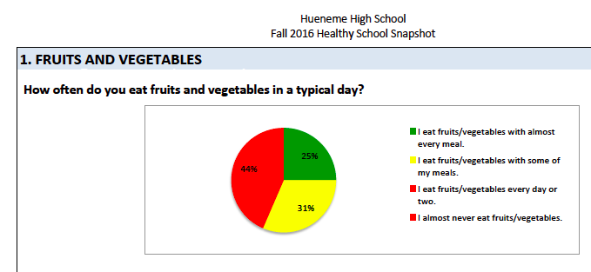
Healthy School Snapshot
Summary of all the Healthy Me Snapshots.
Goal is to be a representative sample of your school.
Reflect:
How do you
think you can you
use this tool for
Café o Yea?
www.healthcorps.org

Slide 4
New Café O Yea Goals
Engage with as many participants as possible in COYs that promote healthy decision making skills.
Evaluate reach and exposure to COYs, and student participants’ intention to try a new skill and share it with others.
Engage key stakeholders in existing school systems, to enhance wellness (e.g. school food, PE program, classroom curriculum, etc.)
www.healthcorps.org

Slide 5
New Café O Yea Criteria
Show a demonstrable skill that participants can do on his/her own and share with friends and family (e.g. a recipe).
Build student leader capacity to plan and implement demonstrations by having planning session(s).
Create visuals and signage with key takeaway messages and have recipe cards for nutrition-related topics.
www.healthcorps.org

Slide 6
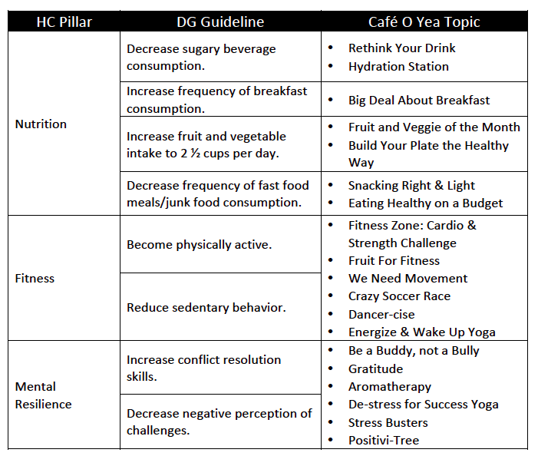

Introducing… the COY Library!

Slide 7
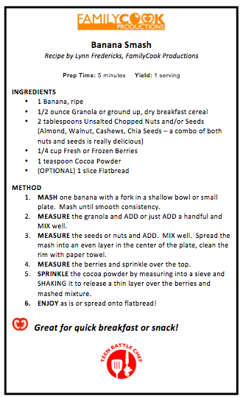
Example Recipes
Banana Smash
Fruit Tarts
Kale and Chili Eggs
Overnight Apple Oats
Veggie Mug Omelet
Yogurt Parfait

Slide 8

Notes:
https://www.youtube.com/watch?v=YJrJy_V2Nl4

Slide 9
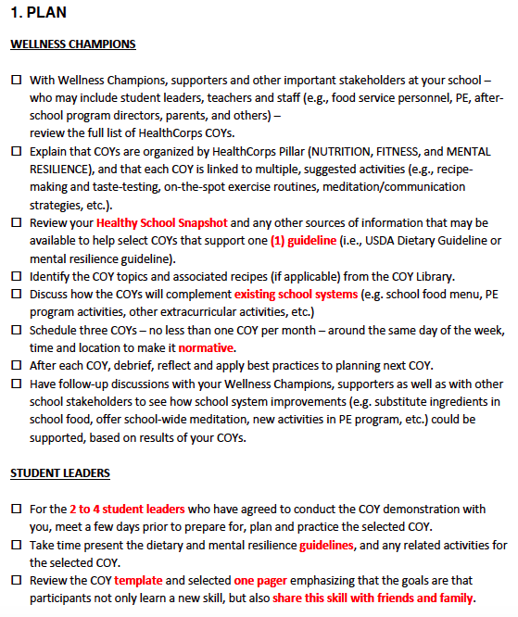
COY Steps
Plan
Wellness Champions
Student Leaders
Implement…
Evaluate…
www.healthcorps.org

Slide 10
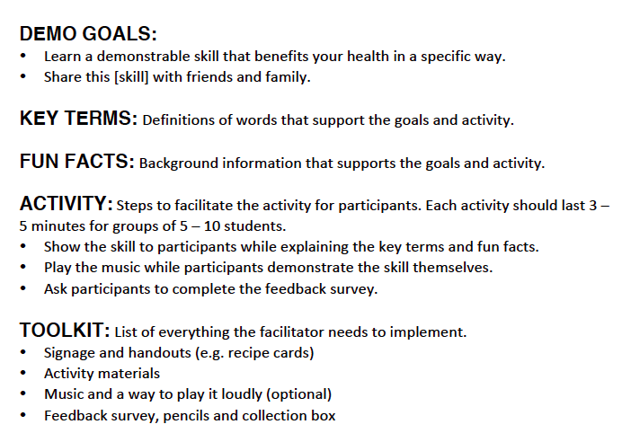
The COY Template
What’s Snacking Right and Light’s?
What’s We Need Movement’s?
What’s Positivi-Tree’s?
www.healthcorps.org

Slide 11
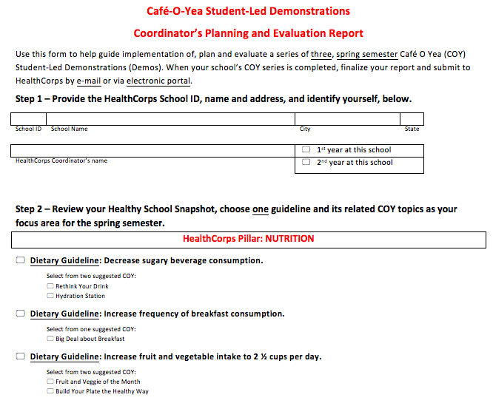
COY Evaluation
Coordinator Report
www.healthcorps.org

Slide 12
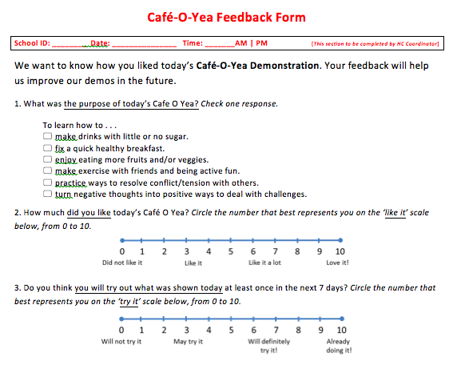
COY Evaluation
Participant Feedback Form
www.healthcorps.org

Slide 13
FAQ
How do I select topics if I do not have a Healthy School Snapshot?
Can Café O Yeas at Health Fairs count towards my three?
What is the goal amount of eval forms to collect each Cafe O Yea?
What’s the timeline to submit the eval forms?
www.healthcorps.org

